Slide 1
Unit Test In A Nutshell
Software engineering is what happens to programming
when you add time and other programmers

Slide 2
Tại sao cần unit test
Đảm bảo nó chạy hôm nay, và nó vẫn chạy ở tương lai.
Unit tests cũng như một phần document. Nó không thay thế việc viết doc, có nó thì doc sẽ rõ ràng hơn.
Nếu tính trên ROI (Return On Investment) unit test không có nhiều giá trị trong thời điểm hiện tại. Nó có nhiều giá trị ở tương lai.
Unit tests loại bỏ regression test (dĩ nhiên là trên phần code viết được unit test).
Unit tests can help restore confidence and increase understanding.
Unit tests không đảm bảo code sẽ không có bugs, có thể sẽ ít bugs hơn. Tuy nhiên một khi đã fix được bug đó thì nó sẽ không xảy ra nữa => Tiết kiệm thời gian ở tương lai.
Unit tests giúp việc refactor dễ dàng hơn.
Notes:
Unit tests can help restore confidence and increase understanding: code của người khác, code của bạn nhưng sau 6 tháng)

Slide 3
Dependency inversion principle
“High level modules should not depend on low level modules. Both should depend on abstractions. Abstractions should not depend upon details. Details should depend on abstractions”

Slide 4
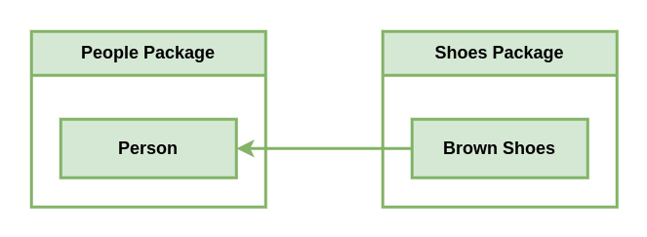
Dependency inversion principle

Slide 5
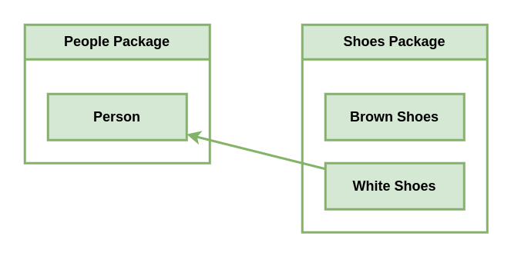
Dependency inversion principle

Slide 6
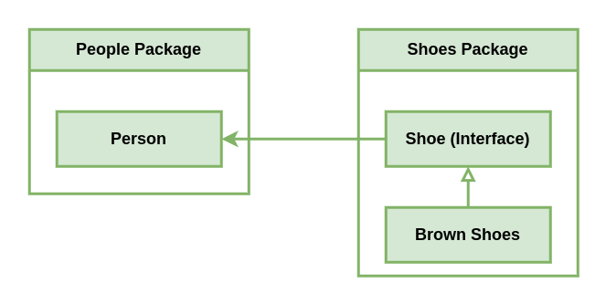
Dependency inversion principle

Slide 7
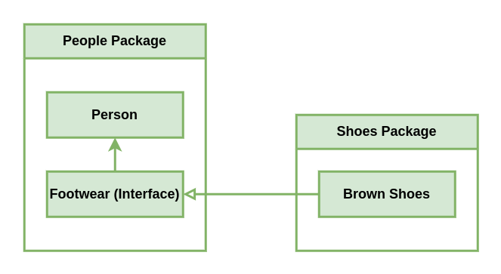
Dependency inversion principle

Slide 8
Dependency inversion principle
Go support for implicit interfaces and we can leverage that to define our dependencies as interfaces in the same package, rather than importing an interface from another package.
It could even result in a small amount of duplication. You will find, however, that the interfaces you would have defined without dependency inversion would have been fatter and more unwieldy, a fact that would have cost you more to work with in the future.
After applying DIP, you are unlikely to have any circular dependency issues. In fact, many packages will only be imported by the main package.

Slide 9
Test-specific techniques
Table-driven tests
Stubs
Mocks

Slide 10
Table-driven tests
https://github.com/cweill/gotests

Slide 11
Stubs
Stubs are fake implementations of a dependency (that is, an interface) that provides a predictable, usually fixed result.

Slide 12
Mocks
Mocks are very much like stubs, but they have one fundamental difference. Mocks have expectations. When we used stubs, our tests did nothing to validate our usage of the dependency; with mocks, they will.

Slide 13
Test coverage
test coverage = (lines of code covered by tests / total lines of code) * 100

Slide 14
Make sure log is run
gmicro default to to stdout. How to test it is log.

Slide 15
References
https://www.youtube.com/watch?v=X4rxi9jStLo&t

